Slide 1
Variables and Data Types in Java
A variable is a container which holds the value while the java program is executed. A variable is assigned with a datatype.
Variable is a name of memory location. There are three types of variables in java: local, instance and static.
There are two types of data types in java: primitive and non-primitive

Slide 2
Variable Variable is name of reserved area allocated in memory. In other words, it is a name of memory location. It is a combination of "vary + able" that means its value can be changed.
int data=50;//Here data is variable

Slide 3
Types of Variable There are three types of variables in java: local variable instance variable static variable

Slide 4
1) Local Variable
A variable declared inside the method is called local variable.
2) Instance Variable
A variable declared inside the class but outside the method, is called instance variable . It is not declared as static.
3) Static variable
A variable which is declared as static is called static variable. It cannot be local.

Slide 5
Example to understand the types of variables in java
class A{
int data=50;//instance variable
static int m=100;//static variable
void method(){
int n=90;//local variable
}
}//end of class

Slide 6
Data Types in Java
Data types represent the different values to be stored in the variable. In java, there are two types of data types:
Primitive data types
Non-primitive data types

Slide 7
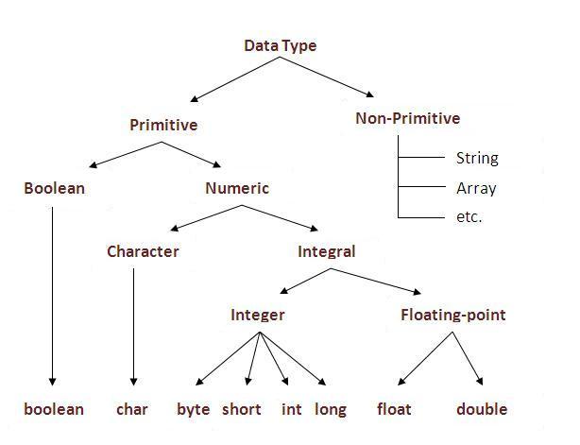

Slide 8
Data Type | Default Value | Default size
boolean | false | 1 bit
char | '\u0000' | 2 byte
byte | 0 | 1 byte
short | 0 | 2 byte
int | 0 | 4 byte
long | 0L | 8 byte
float | 0.0f | 4 byte
double | 0.0d | 8 byte

Slide 9
Java Variable Example: Add Two Numbers
class Simple{
public static void main(String[] args){
int a=10;
int b=10;
int c=a+b;
System.out.println(c);
}}

Slide 10
Java Variable Example: Widening
class Simple{
public static void main(String[] args){
int a=10;
float f=a;
System.out.println(a);
System.out.println(f);
}}

Slide 11
Java Variable Example: Narrowing (Typecasting)
class Simple{
public static void main(String[] args){
float f=10.5f;
//int a=f;//Compile time error
int a=(int)f;
System.out.println(f);
System.out.println(a);
}}

Slide 12
Java Variable Example: Overflow
class Simple{
public static void main(String[] args){
//Overflow
int a=130;
byte b=(byte)a;
System.out.println(a);
System.out.println(b);
}}

Slide 13
Java Variable Example: Adding Lower Type
class Simple{
public static void main(String[] args){
byte a=10;
byte b=10;
//byte c=a+b;//Compile Time Error: because a+b=20 will be int
byte c=(byte)(a+b);
System.out.println(c);
}}

Slide 14
Operators in java
Operator in java is a symbol that is used to perform operations. For example: +, -, *, / etc.
There are many types of operators in java which are given below:
Unary Operator,
Arithmetic Operator,
Shift Operator,
Relational Operator,
Bitwise Operator,
Logical Operator,
Ternary Operator and
Assignment Operator.

Slide 15
Java Operator Precedence
Operator Type | Category | Precedence
Unary | postfix | expr++ expr--
 | prefix | ++expr --expr +expr -expr ~ !
Arithmetic | multiplicative | * / %
 | additive | + -
Shift | shift | << >> >>>
Relational | comparison | < > <= >= instanceof
 | equality | == !=
Bitwise | bitwise AND | &
 | bitwise exclusive OR | ^
 | bitwise inclusive OR | |
Logical | logical AND | &&
 | logical OR | ||
Ternary | ternary | ? :
Assignment | assignment | = += -= *= /= %= &= ^= |= <<= >>= >>>=

Slide 16
Java Unary Operator
The Java unary operators require only one operand. Unary operators are used to perform various operations i.e.:
incrementing/decrementing a value by one
negating an expression
inverting the value of a boolean

Slide 17
Java Unary Operator Example: ++ and --
class OperatorExample{
public static void main(String args[]){
int x=10;
System.out.println(x++);//10 (11)
System.out.println(++x);//12
System.out.println(x--);//12 (11)
System.out.println(--x);//10
}}

